Slide 1
BCP & DRP

Slide 2
Business Continuity & Disaster Recovery Planning
The Business Continuity Planning (BCP) and Disaster Recovery Planning (DRP) addresses the preservation of the business in the face of major disruptions to normal business operations.
BCP and DRP involve the preparation, testing and updating of specific actions to protect critical business processes from the effect of major system and network failures.
BCP helps to identify the organization’s exposure to internal and external threats; synthesize hard and soft assets to provide effective prevention and recovery for the organization, and maintains competitive advantage and value system integrity.
BCP counteracts interruptions to business activities and should be available to protect critical business processes from the effects of major failures or disasters. It deals with the natural and man-made events and the consequences, if not dealt with promptly and effectively.

Slide 3
BIA and DRP
Business Impact Analysis (BIA) determines the proportion of impact an individual business unit would sustain subsequent to a significant interruption of computing or telecommunication services. These impacts may be financial, in terms of monetary loss, or operational, in terms of inability to deliver.
Disaster Recovery Plans (DRP) contains procedures for emergency response, extended backup operations and post-disaster recovery, should a computer installation experience a partial or total loss of computer resources and physical facilities. The primary objective of the disaster recovery plan is to provide the capability to process mission-essential applications, in a degraded mode, and return to normal mode of operation within a reasonable amount of time.

Slide 4
Business Disruption
An organization is dependent on resources, personnel and tasks performed on a daily bases to be healthy and profitable. Loss or disruption of these resources can be detrimental. Causing great damage or even complete destruction of the business.
Business MUST have a plan to deal with unforeseen events.

Slide 5
Why a Business Requires BCP?
Provide an immediate response to emergency situations
Protect lives and ensure safety
Reduce business impact
Resume critical business functions
Reduce confusion during a crisis
Ensure survivability of the business
Get up and running ASAP after a disaster

Slide 6
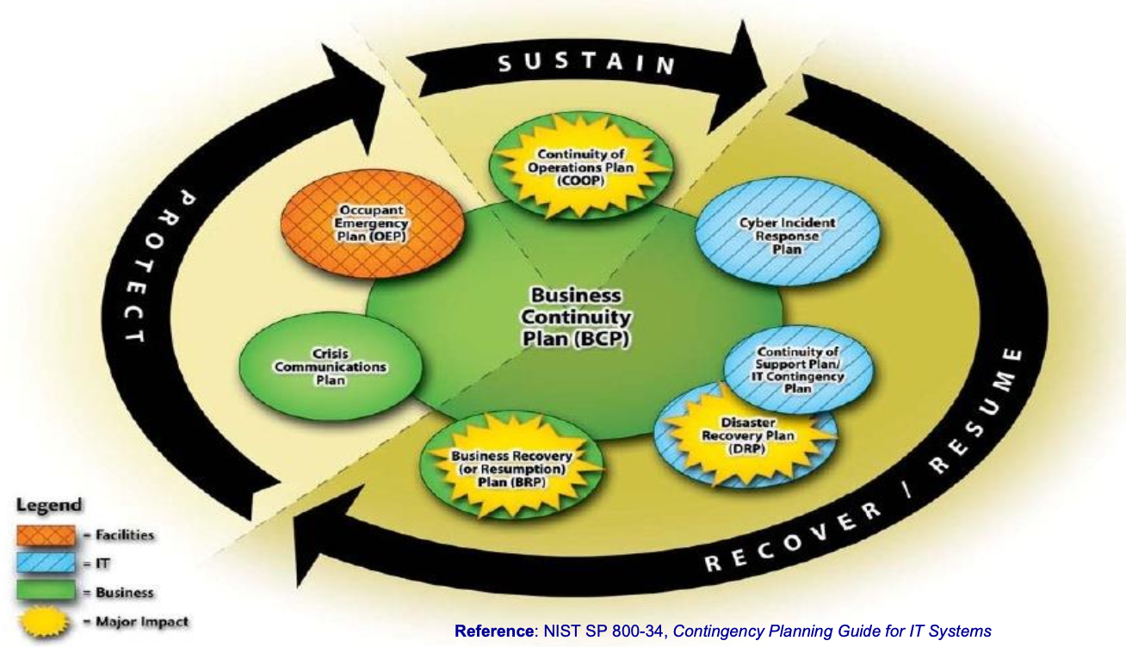
Life Cycle of Business Continuity
Sustain business operations
Recover / resume business operations
Protect business assets (People, reputation, and tangible assets)

Slide 7
Process of Creating BCP
Phase I: Project Initiation
Phase II: Business Impact Analysis (BIA)
Phase III: Recovery Strategy
Phase IV: Plan Design & Development
Phase V: Implementation
Phase VI: Testing
Phase VII: Maintenance, Awareness, and Training

Slide 8
Phase I: Project Management and Initiation
Procedure to initiate a BCP project…
Step 1: Establish the need.
Step 2: Obtain management support.
Step 3: Identify stakeholders and resources.
Step 4: Create an project management work plan.

Slide 9
Phase I: Project Management and Initiation
In this step
we must solidify managements support, because without management support, NOTHING will be successful.
Develop a “Continuity Planning Policy Statement” – lays out the scope of the BCP project, roles and members, and goals.
We then must identify a “Business Continuity Coordinator” (the BCP team leader)
Establish a BCP team
What types of people/roles should be on the team…
Which people will be chosen for the team

Slide 10
Obtain Management Support & Plan Project
Obtain management support and identify stakeholders.
Identify strategic internal and external resources to ensure that BCP matches overall business and technology plans.
Establish the project management work plan, including the:
Define scope and objectives of the project.
Determine methods for organizing and managing development of the BCP.
Establish members of the BCP team (both technical & functional).
Identification of related tasks and responsibilities.
Schedule project management reviews (PMR) and set project milestones.

Slide 11
Role & Responsibility of a BCP Coordinator
To serve as the liaison between the planning, development team and management.
Have direct access and authority to interact with all employees necessary to complete the planning.
Possess a thorough business knowledge to understand how an outage can affect the organization.
Be familiar with the entire organization and in a position within the organization to balance the overall needs of the organization with the needs of individual business units that would be affected.
Have easy access to executive management.
Understand the charter, mission statement, and executive viewpoint when decisions need to be made.

Slide 12
Phase II: Business Impact Analysis (BIA)
Provide written documentation to assist the organization’s management in understanding the business impact associated with possible outages.
Identify an organization’s business functions and associated information systems to determine how critical those functions are to the organization.
Identify any concerns that staff or management may have regarding the ability to function in less than optimal modes
Prioritize critical information systems.
Analyze impact of an outage, such as loss of revenue, additional operating expenses, delay of income, and loss of competitive advantage and public confidence
Determine recovery windows for each business function, such as determining how long the organization may be able to perform critical functions manually or through some other alternative methods.

Slide 13
Business Impact Analysis (BIA)
BIA is a management-level functional analysis that identifies the impact to business operations should an outage occur.
BIA leverages information from risk assessment, but it is not only an IT risk assessment.
Impact is measured by:
Tangible attributes:
Allowable business interruption – Maximum Tolerable Downtime (MTD) or Maximum Tolerable Outage (MTO)
Financial cost considerations.
Regulatory requirements.
Intangible attributes:
Organizational reputation.

Slide 14
Phase III: Recovery Strategy
Recovery strategy is a set of predefined & management approved actions implemented in response to a business interruption from a disaster.
Natural / Environmental
Earthquakes, floods, storms, hurricanes, fires, snow/ice, etc.
Man made / political events
Explosives, disgruntled employees, unauthorized access, employee errors, espionage, sabotage, arson/fires, hazardous/toxic spills, chemical contamination, malicious code, vandalism and theft, etc.
Recovery strategy focuses on:
Meeting the predetermined recovery time frames (i.e. MTD).
Maintaining the operation of the critical business functions.
Compiling the resource requirements.
Identifying alternatives that are available for recovery.

Slide 15
Procedure for developing a recovery strategy
Step 1: Document all costs associated with each contingencies.
Step 2: Obtain cost estimates for any outside services (using RFI, RFQ, or RFP).
Step 3: Develop written agreements for outside services (i.e. Service Level Agreement (SLA)).
Step 4: Evaluate resumption strategies based on a full loss of the facility.
Step 5: Identify risk reduction measures and update Business Resumption Plan (BRP).
Step 6: Document recovery strategies and present to management for comments and approval.

Slide 16
Elements of Recovery
Business recovery strategy
Focus on recovery of business operations.
Facility & supply recovery strategy
Focus on facility restoration and enable alternate recovery site(s).
User recovery strategy
Focus on people and accommodations.
Technical recovery strategy
Focus on recovery of IT services.
Data recovery strategy
Focus on recovery of information assets.

Slide 17
Business Recovery
Business recovery strategy focuses on recovery of business operations by identifying:
Critical business units and their associated business functions.
Critical IT system requirements for each business function.
Critical office equipment and supplies requirements for each business function.
Essential office space requirements for each business unit.
Key operations personnel for each business unit.
Supporting infrastructure (i.e. telecom., utilities, and postal service) for service redirection to recovery site(s).
Business unit interdependencies.
Off-site storage.

Slide 18
User recovery
User recovery strategy focuses on:
Contingency business operations procedures (manual or automated).
Employee access procedure for recovery site.
Transport and storage of critical business documentation and forms.
Storage of vital records (i.e. personnel, legal business, and medical records, etc.)
Employee notification procedures.
Transportation arrangements for employee to recovery site.
Employee accommodations (e.g. user workspace, equipment, food, water, sleeping, and plumbing, etc.)

Slide 19
Technical Recovery
Technical recovery strategy focuses on:
Data Center Recovery
Network and Data Communication Recovery Planning
Telecommunications Recovery

Slide 20
Technical Recovery
The key elements to the technical recovery are:
Subscription Services
Hot Site
Warm Site
Cold Site
Mirror Site or Multiple Processing Centers
Mobile site
Reciprocal or Mutual Aide Agreement
Service Bureaus

Slide 21
Subscription Service: Hot Site
A Hot Site is a fully configured computer facility with complete customer required systems
Computing infrastructure (i.e. servers, workstations, and networks)
Critical infrastructure (i.e. electricity, water, HVAC, physical security, etc.)
Advantage
24/7 availability.
Disadvantage
Expensive to maintain.
Need data restoration from backup. (Data is not mirrored)
The service provider might oversell capacity, thus create possible contentions for resources between multiple companies during a regional disaster.
Security control of information asset must be maintained in multiple places.

Slide 22
Subscription Service: Warm Site
A Warm Site is a facility readily available with electrical power and HVAC and computers, but the applications may not be installed.
Advantages
Availability is assured for longer timeframes.
Cost is less than a hot site subscription service.
Flexible in the choice of sites (i.e. locations).
Uses less administrative resources than a hot site.
Disadvantage
Operational testing is not possible.
Required resources may not be immediately available. (i.e. data restoration).
More expensive than a cold site or in-house recovery sites.

Slide 23
Subscription Service: Cold Site
A Cold Site is a facility with critical infrastructure services only. It does not include any IT equipment, or resources.
Advantages
Lower cost than hot or warm site subscription service.
Available for longer periods of time.
Site can be in various locations.
Disadvantage
Required resources may not be immediately available. (i.e. equipment transport, setup, and data restoration)
Operating testing is not possible.
Costs are more expensive than in-house facilities.

Slide 24
Mirror Site or Multiple Processing Centers
The information processing is distributed over multiple data centers. The available resources are shared & fully redundant.
Advantage
No MTD issue, minimal business impact when there is a disaster at one site.
The organization have full control over all data centers.
Resources are fully available.
Disadvantage
For distributed Multiple Processing Centers: Shared computing resources may not maintain excess capacity, then a major disaster could easily overtake the processing capability of processing sites.
If maintain excess capacity for major disaster, it can be cost prohibitive.
Logistics of maintaining multiple sites may lead to CM problems.

Slide 25
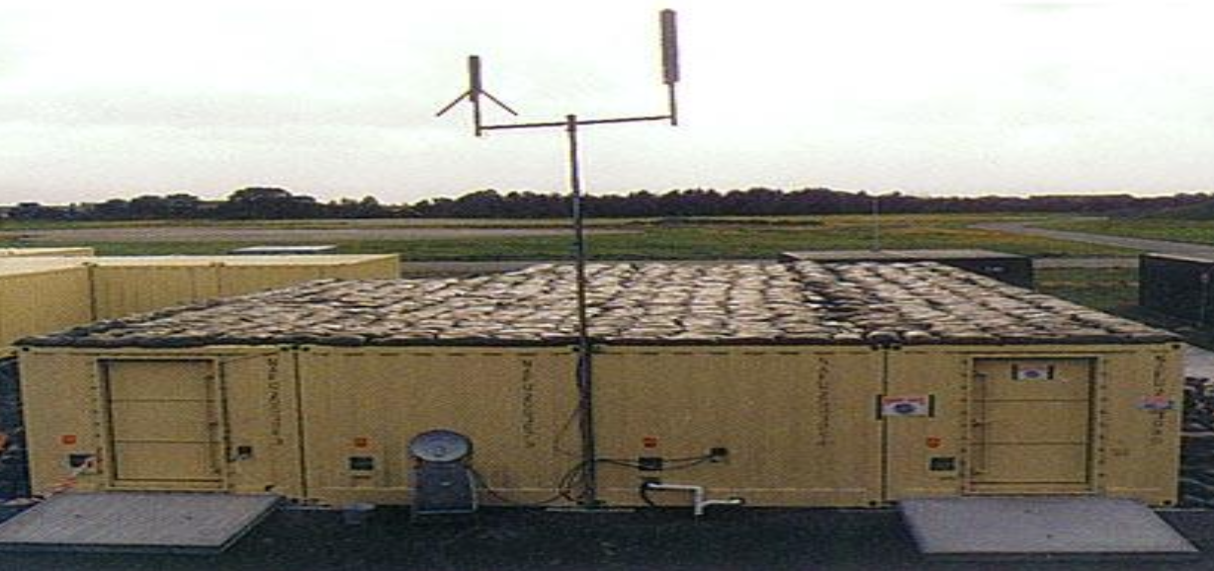
Mobile Site
A Mobile Site is self-contained, transportable shelter custom-fitted with specific telecommunications and IT equipment.
Advantage
The organization have full control over all equipment.
Disadvantage
May offer limited information processing capacity (, as compared to the primary data center.)
Require advance coordination, resources may not be immediately available (i.e. equipment transport, setup, and data restoration.)

Slide 26
Phase IV: Plan Design & Development
Step 1: Determine management concerns & priorities.
Step 2: Determine planning scope such as geographical concerns, organizational issues, and the various recovery functions to be covered in the plan.
Step 3: Establish outage assumptions.
Step 4: Define prevention strategies for risk management, physical security, information security, insurance coverage, and how to mitigate the emergency.
Step 5: Identify resumption strategies for mission critical- and non-mission critical-systems at alternate sites.
Step 6: Identify the location for the emergency operations center/ command center.

Slide 27
Phase IV: Plan Design & Development
Step 7: Develop service function recovery plans, including information processing, telecommunications, etc.
Step 8: Develop business function recovery plans and procedures.
Step 9: Develop facility recovery plans.
Step 10: Identify the response procedures, including:
Evacuation and safety of personnel
Notification of disaster
Notifying alternate site(s)
Initial damage assessment
Securing home site
Activating recovery teams, and emergency operations center/command center
Relocating to alternate site(s)

Slide 28
Phase IV: Plan Design & Development
Step 11: Gather data required for plan completion. Develop support service plans, including human resources, public relations, transportation, facilities, information processing, telecommunications, etc.
Step 12: Review and outline how the organization will interface with external groups.
Step 13: Review and outline how the organization will cope with other complications beyond the actual disaster.

Slide 29
Phase V: Implementation
Execute BCP as an integrated program that consists of…
Business Resumption Plan
Continuity of Operations (COOP) Plan
IT Contingency Plan
Crisis Communications Plan
Cyber Incident Response Plan
Disaster Recovery Plan
Occupant Emergency Plan

Slide 30
Phase VI: Testing
Structured walk-through: Representatives from each department come together AS A GROUP, they walk through the plan and different scenarios from beginning to end to make sure nothing is left out.
Checklist test: BCP is distributed to departments and functional areas for review. The Managers read over and indicate if anything is missing or should be modified. Each functional representatives review BCP plans and check off the points that are listed to ensure all concerns and activities are addressed.

Slide 31
Phase VI: Testing
Simulation: A specific scenario is proposed, all required employees come together and start to simulate that the event has happened and start taking action to recover. The idea is to see if any problems come up or if any concerns were left out.
Parallel test: Some systems are moved to the alternate site and processing takes place. The results are compared to the real processing to see if anything needs to change.
Full interruption test: Full scale operational test including shutdown of primary site and recovery of business operations at alternate site(s).

Slide 32
Phase VII: Maintenance, Awareness, and Training
Monitor configuration management (CM) and update BCP plans accordingly.
Plan & schedule BCP maintenance reviews (Minimum: Annually review).
Distribute updates to BCP plans.

Slide 33
BCP Awareness and Training
Like Security Awareness
& Training, BCP awareness on policy and procedures should be conducted annually to all employees & contractors.
BCP training should role-based that focuses on a specific functional area(s).

